Slide 1
Care for all that is you
Fairfax County Public Schools

Slide 2
Experience health care designed with you in mind
You deserve high-quality care for your total health, whatever you need — from routine checkups to complex treatments to mental wellness support.
No matter what your priority is, ours is providing excellent care — for the you who’s feeling great, the you who needs support, and every you in between.
8 | ©2025 Kaiser Foundation Health Plan, Inc.

Slide 3
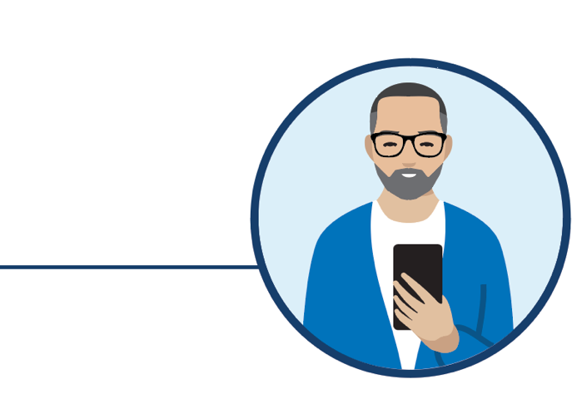
Why choose Kaiser Permanente?
High-quality, personalized care
From prevention to primary care to specialized care
With doctors who learn your lifestyle, health risks, and goals
Care teams connected to your medical history through your electronic health record
Convenient access
With 24/7 care by phone or video¹
On one app that makes care easy to manage
At facilities that offer more services in one stop
Support for total health
Help with mental health concerns from any member of your care team
Self-care apps, classes, services, and programs^{2,3}
Resources to help you achieve your health and fitness goals
1. When appropriate and available. 2. The apps and services described above are not covered under your health plan benefits, are not a Medicare-covered benefit, and are not subject to the terms set forth in your Evidence of Coverage or other plan documents. The apps and services may be discontinued at any time. 3. Some classes may require a fee.
3
| ©2025 Kaiser Foundation Health Plan, Inc.

Slide 4
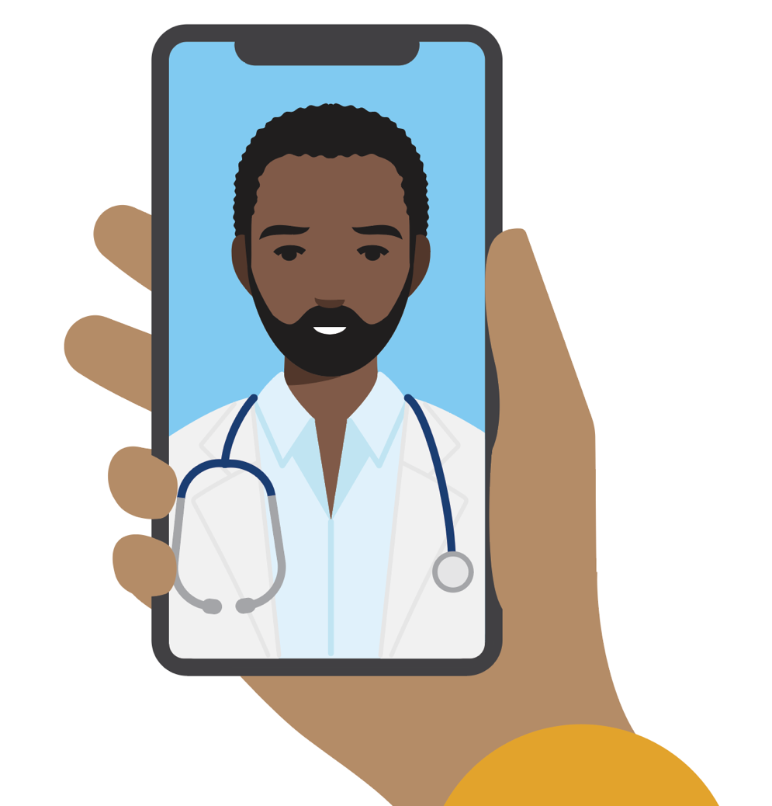
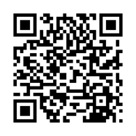
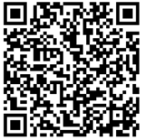
Care that’s convenient
We make it easy to get high-quality care when and where you want it. No matter how you connect, you’ll always talk with a medical professional who can see your health history, so you never have to repeat your story.
Your health at your fingertips
Get 24/7 care by phone or video.¹
Email your care team.
Schedule routine appointments.
View most lab results and doctor’s notes.
Refill most prescriptions.
Check in for appointments.
Pay bills and view statements.
Simplify your health care with the Kaiser Permanente app.
Over half of members
avoided a trip to the ER
or urgent care with a video visit.²
1. When appropriate and available. 2. Kaiser Permanente internal data, 2023.
4
| ©2025 Kaiser Foundation Health Plan, Inc.

Slide 5
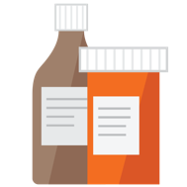
Convenient prescription refills
Order prescription refills online, on the Kaiser Permanente app, in person, over the phone, or by mail order.
You can get refill reminders or alerts when new prescriptions are available to order. Track your order online and get delivery updates by text or email.
Mail-order pharmacy
Easy refills online, in person, or over the phone
Same-day pickup
Most prescriptions delivered to your front door¹
Same-day or next-day home delivery available for an additional fee²
1. Not all prescriptions can be mailed, restrictions may apply. Please check with your local pharmacy. 2. Same-day and next-day prescription delivery services may be available for an additional fee. These services aren’t covered under your health plan benefits and may be limited to specific prescription drugs, pharmacies, and areas. Order cutoff times and delivery days may vary by pharmacy location. Kaiser Permanente isn’t responsible for delivery delays by mail carriers. Kaiser Permanente may discontinue same-day and next-day prescription delivery services at any time without notice and other restrictions may apply. Medi-Cal and Medicaid beneficiaries should ask their pharmacy for more information about prescription delivery.
5
| ©2025 Kaiser Foundation Health Plan, Inc.

Slide 6
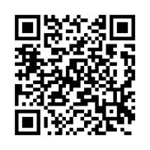
Convenient care while traveling
Planning a trip? Have a child going away to college? Before you leave, we’ll help you get vaccinated, refill prescriptions, and stay on top of your health while you’re away.
You’re covered for urgent and emergency care anywhere in the world.
You can always get 24/7 care by phone or online across the U.S.*
Learn more about getting care away from home.
*When appropriate and available. If you travel out of state, phone appointments and video visits may not be available in select states due to licensing laws. Laws differ by state.
6
| ©2025 Kaiser Foundation Health Plan, Inc.

Slide 7
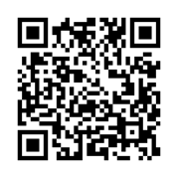
Resources for mental health
Members can get help with depression, anxiety, addiction, and mental or emotional health — without a referral for mental health care within Kaiser Permanente. Share your concerns with anyone on your care team at any time, and they can connect you to the support you need.
Individual or group therapy
Health classes¹
Medication
Online resources
Apps for mental wellness and self-care²
Not sure where to start? Talk to your personal doctor about your concerns or call us to talk with our mental health team.
Find mental health and wellness resources that fit your life.
1. Some classes may require a fee. 2. The apps and services described above are not covered under your health plan benefits, are not a Medicare-covered benefit, and are not subject to the terms set forth in your Evidence of Coverage or other plan documents. The apps and services may be discontinued at any time.
7
| ©2025 Kaiser Foundation Health Plan, Inc.

Slide 8
Resources for everyday wellness
Take advantage of classes, services, and programs to help you achieve your health and fitness goals.¹
Reduced rates on gym memberships
Wellness coaching by phone
Healthy lifestyle programs and classes²
Online fitness classes
1. These services aren’t covered under your health plan benefits and aren’t subject to the terms set forth in your Evidence of Coverage or other plan documents. These services may be discontinued at any time without notice. 2. Some classes may require a fee.
8
| ©2025 Kaiser Foundation Health Plan, Inc.

Slide 9
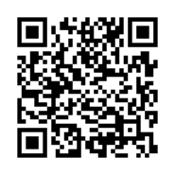
World-class maternity care
Expect great care when you’re expecting
A dedicated prenatal care team
A personalized birth plan
Care and support every step of the way
Support that doesn’t stop at delivery
Learn more about maternity care that's built around you.
9
| ©2025 Kaiser Foundation Health Plan, Inc.

Slide 10
HMO SIGNATURE
This table shows an example of some of your group’s benefits.
Yearly deductible | $0 individual/$0 family
Maximum yearly out-of-pocket costs | $2,000 individual/$4,000 family
Covered service | You pay
Preventive care | $0 copay
Doctor’s office visit | $20 copay PCP $40 copay Specialist
Lab tests and radiology | $0 copay
Outpatient surgery | $75 copay
Hospitalization | $150 copay
Emergency care | $250 copay
Prescribed medications (30-day supply) | $10 copay for generic $20 copay for preferred brand $35 copay for non-preferred brand
*This is a summary of some benefits and their copays and coinsurance. For specific information about your covered health plan benefits, limitations, and exclusions, including those not listed in this summary, please see your Evidence of Coverage.

Slide 11
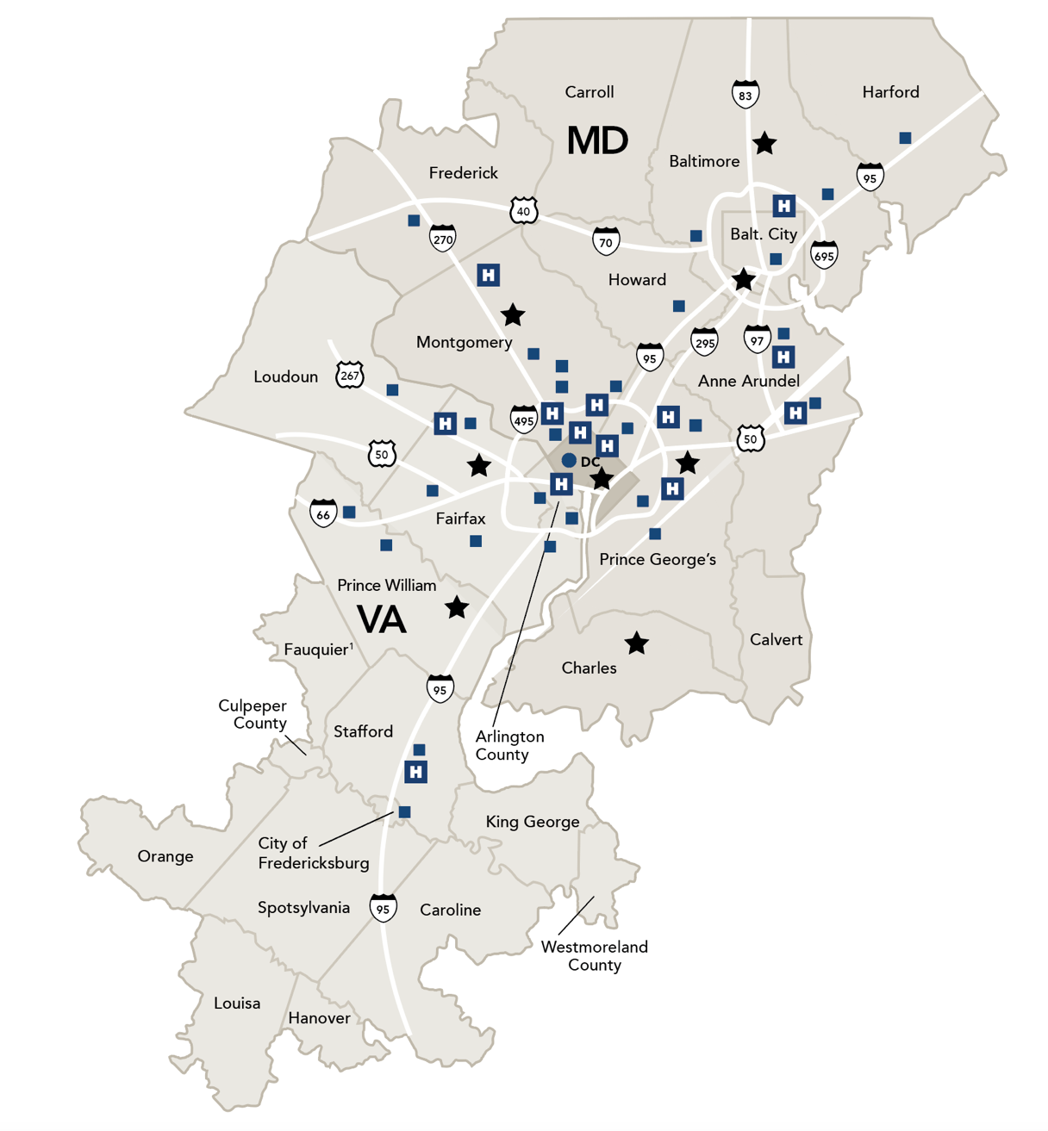
Service areas in Mid-Atlantic States
Portions of Caroline, Fauquier, Hanover, Louisa, Orange, and Westmore and counties
Washington, D.C
Maryland
Anne Arundel County
Baltimore County
Carroll County
Harford County
Howard County
Montgomery County
Prince George’s County
City of Baltimore
Portions of Calvert, Charles, and Frederick counties
Virginia
Arlington County
Fairfax County
King George County
Loudoun County
Prince William County
Spotsylvania County
Stafford County
Cities of Alexandria, Fairfax, Falls Church, Fredericksburg, Manassas, and Manassas Park
Upcoming Medical Center
Medical Center
Medical center with 24/7 Advanced Urgent Care, lab, pharmacy, and radiology
¹Not in the Kaiser Permanente Medicare Advantage (HMO) service area.
11
| ©2025 Kaiser Foundation Health Plan, Inc.

Slide 12
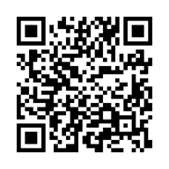
It’s easy to get started
Personalized onboarding
A welcome call to answer your questions
A member guide to get you started
3 easy steps to a healthy change
1. Choose your new doctor.
2. Transition your care and prescriptions seamlessly.
3. Get care on your schedule.
Learn how we make it easy to get care at every step.
12
| ©2025 Kaiser Foundation Health Plan, Inc.

Slide 13
Complete care to help you live a fuller, healthier life
Have questions about your plan options?
Visit kp.org/choosekp to get started.
Talk to an enrollment specialist: 1-800-514-0985 (TTY 711), Monday through Friday, 10 a.m. to 9 p.m. Eastern Standard Time
Mid-Atlantic States Member Services:
1-800-777-7902 (TTY 711)
Monday through Friday, 7:30 a.m. to 9 p.m.
(closed holidays)
Eastern Standard Time
13
| ©2025 Kaiser Foundation Health Plan, Inc.

Slide 14
Thank you
14
| ©2025 Kaiser Foundation Health Plan, Inc.

